Slide 1
18 – Unsupervised Data Mining and Clustering
Dave Eargle – CU Boulder

Slide 2
Clustering
The idea is to identify natural subgroups in data
With supervised segmentation, you identify differences among data with respect to a target variable
“How do people who default on a loan differ from those who do not default?”
With unsupervised segmentation, you do no have a target variable.
You are exploring your data
“Into what natural subgroups do my data fall?”
Another application of the concept of similarity
Identify groups that have high intra-group similarity…
but low inter-group similarity

Slide 3
Why cluster?
Imagine that you are a manufacturer of cars. Why might you want to identify different groups of customers? What kinds of groups might you identify?
Imagine that you are a politician running for election. Why might you want to identify different groups of voters? What kinds of groups might you identify?
With clustering (with understanding natural subgroups), you can develop:
Better products
Better marketing campaigns
Better sales methods
Better customer service

Slide 4
Hierarchical clustering vs Centroid-based clustering
Two different ways of clustering

Slide 5
Hierarchical Clustering
Considers individual points and the distance between them
The idea is to cluster points based on some “link function” – i.e., minimum requirement that must be met before a cluster is merged with another cluster.
For the following slides, we will use the following link function:
“For any given pair of clusters, the Euclidian Distance between the closest two points must be smaller than some threshold in order for the clusters to be merged.”
The chosen “threshold” is arbitrary and exploratory.

Slide 6
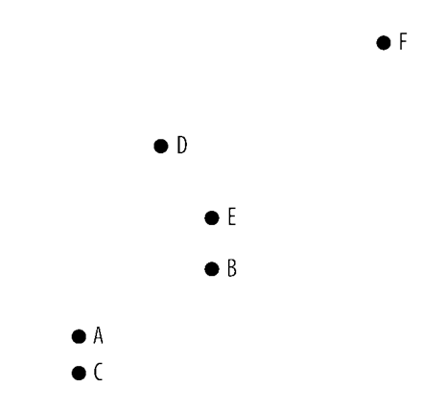
Hierarchical Clustering
Start with 6 points.
Important! At the beginning, each point is its own cluster.
So, 6 clusters.
What will be the next pair of clusters to merge, as we increase the link function threshold?

Slide 7
5 Clusters
What will be the next pair of clusters to merge, as we increase the link function threshold?

Slide 8
4 Clusters
What will be the next pair of clusters to merge, as we increase the link function threshold?

Slide 9
3 Clusters
What will be the next pair of clusters to merge, as we increase the link function threshold?

Slide 10
2 Clusters
What will be the next pair of clusters to merge, as we increase the link function threshold?

Slide 11
1 Cluster
How useful is this clustering output?

Slide 12
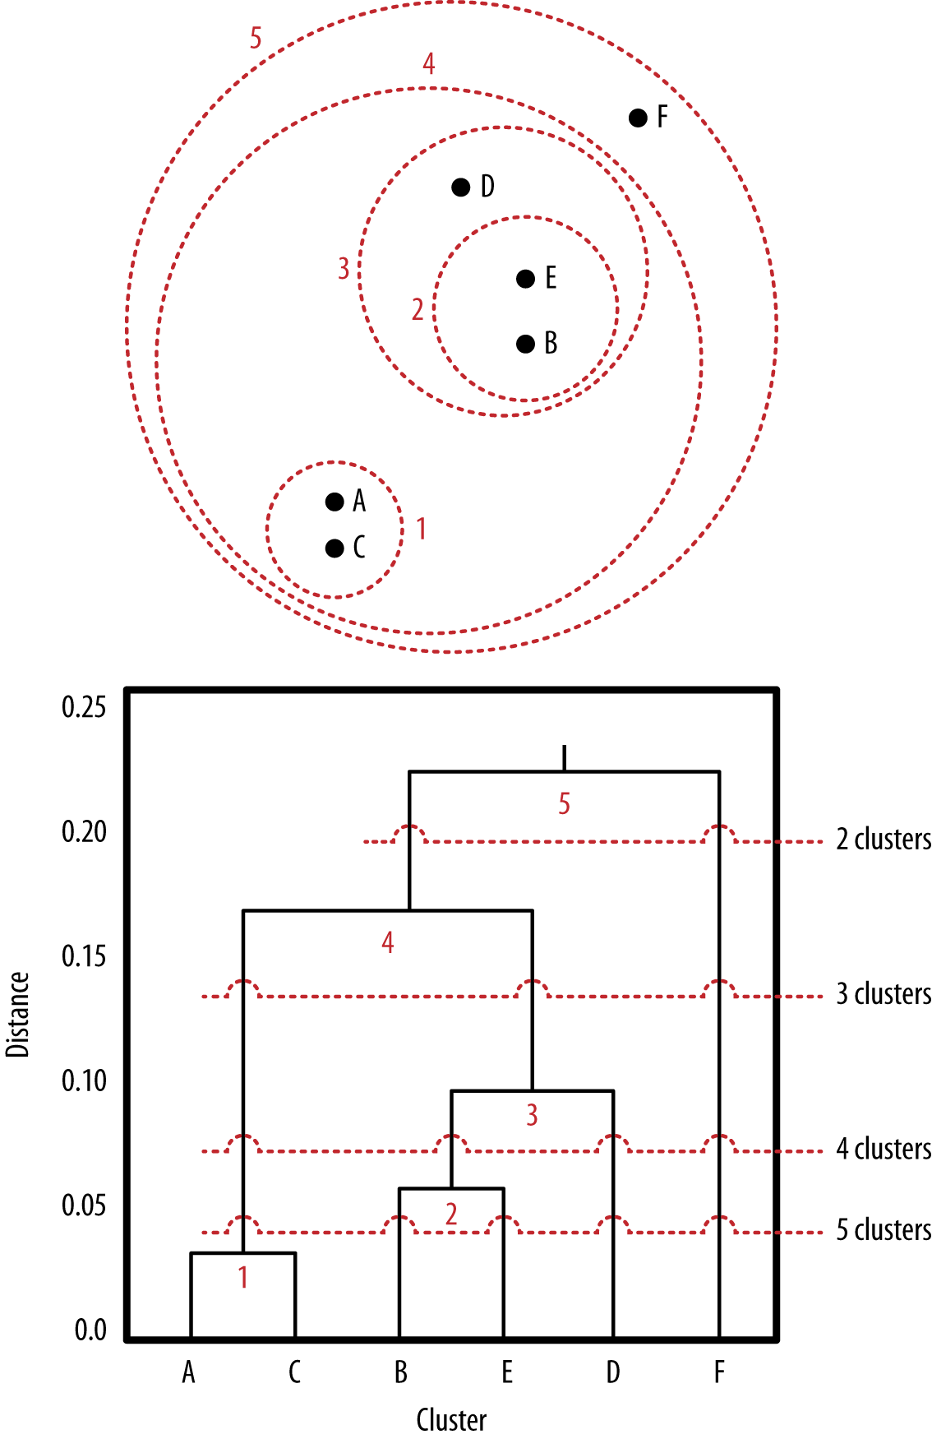
Summary of the merging steps we just did
Slight error – point F should be further away (true on all following slides, too). See previous slides for correct geospacing.

Slide 13
Dendogram – another way of visualizing hierarchical clustering

Slide 14
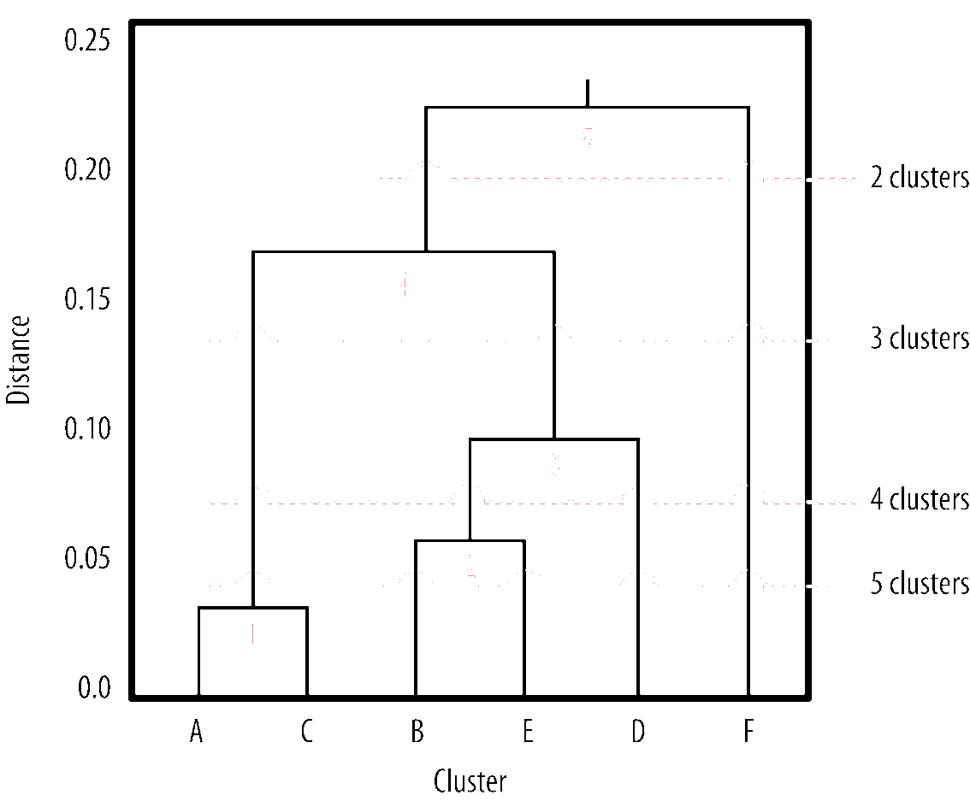
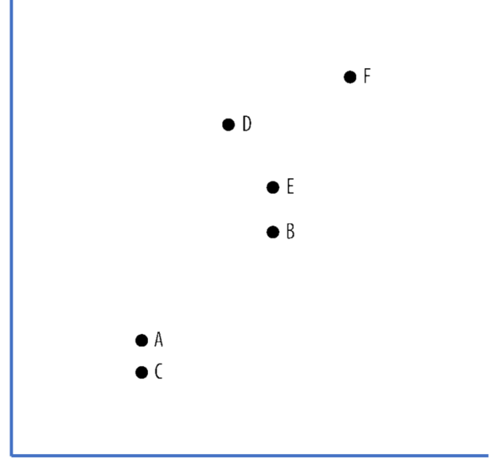
Hierarchical Clustering
Y-axis has our “cutoff threshold” metric.
6 Clusters

Slide 15
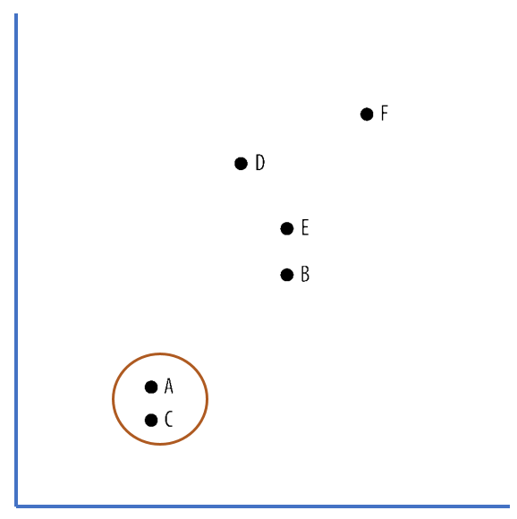

Slide 16
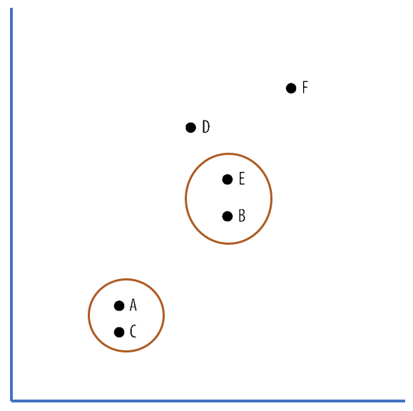

Slide 17
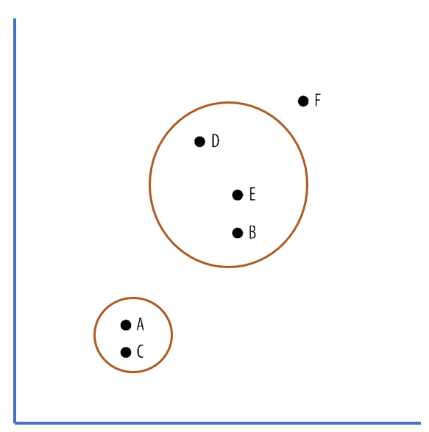

Slide 18
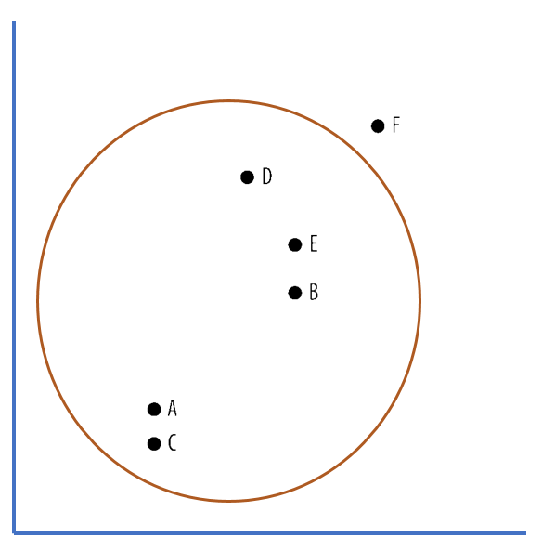

Slide 19
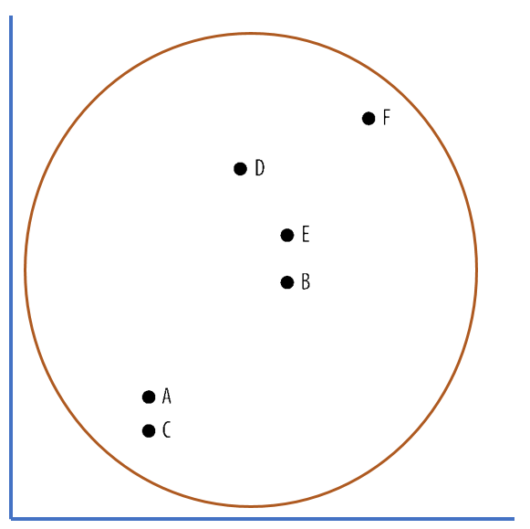
1 Cluster

Slide 20
Again…

Slide 21

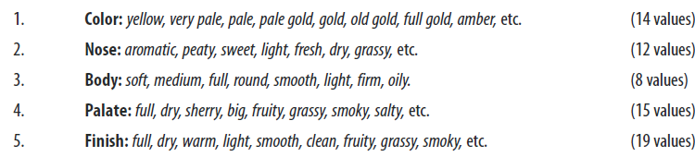
Time for more whiskey
Let’s say we run a small whiskey shop with limited space. We want to identify groups of whiskeys by taste, so that we can:
stock one “well-known” and one “lesser-known” from each “group” of whiskeys. Or,
stock one “expensive” and one “affordable” whiskey from each “group”
etc.
How might we identify “taste groups” of whiskeys? (Groups depending on all possible attributes of “taste”, shown below)
Put another way, how do we identify clusters of “most similar” whiskeys?

Slide 22
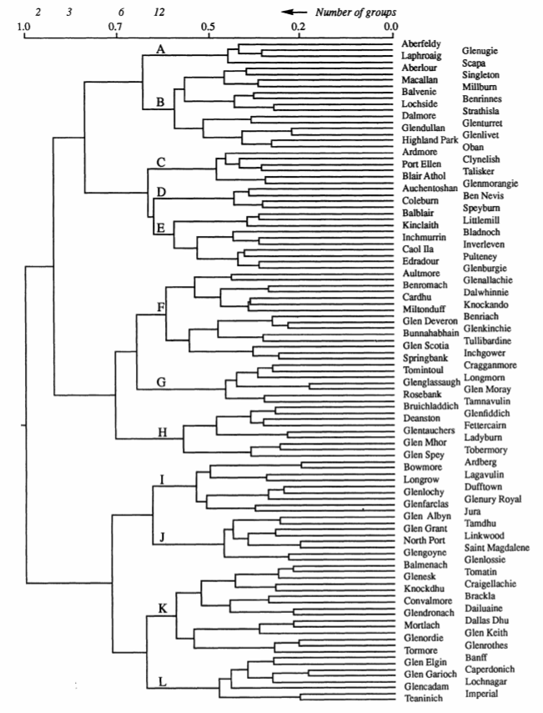
Whiskey dendogram

Slide 23
Whiskey dendogram
Which whiskey is the “last” to cluster? This is the most “unusual” single point.

Slide 24
Whiskey dendogram
Which whiskey is the “last” to cluster? This is the most “unusual” single point.

Slide 25
Whiskey dendogram
Which whiskeys are similar to Bunnahabhain?

Slide 26
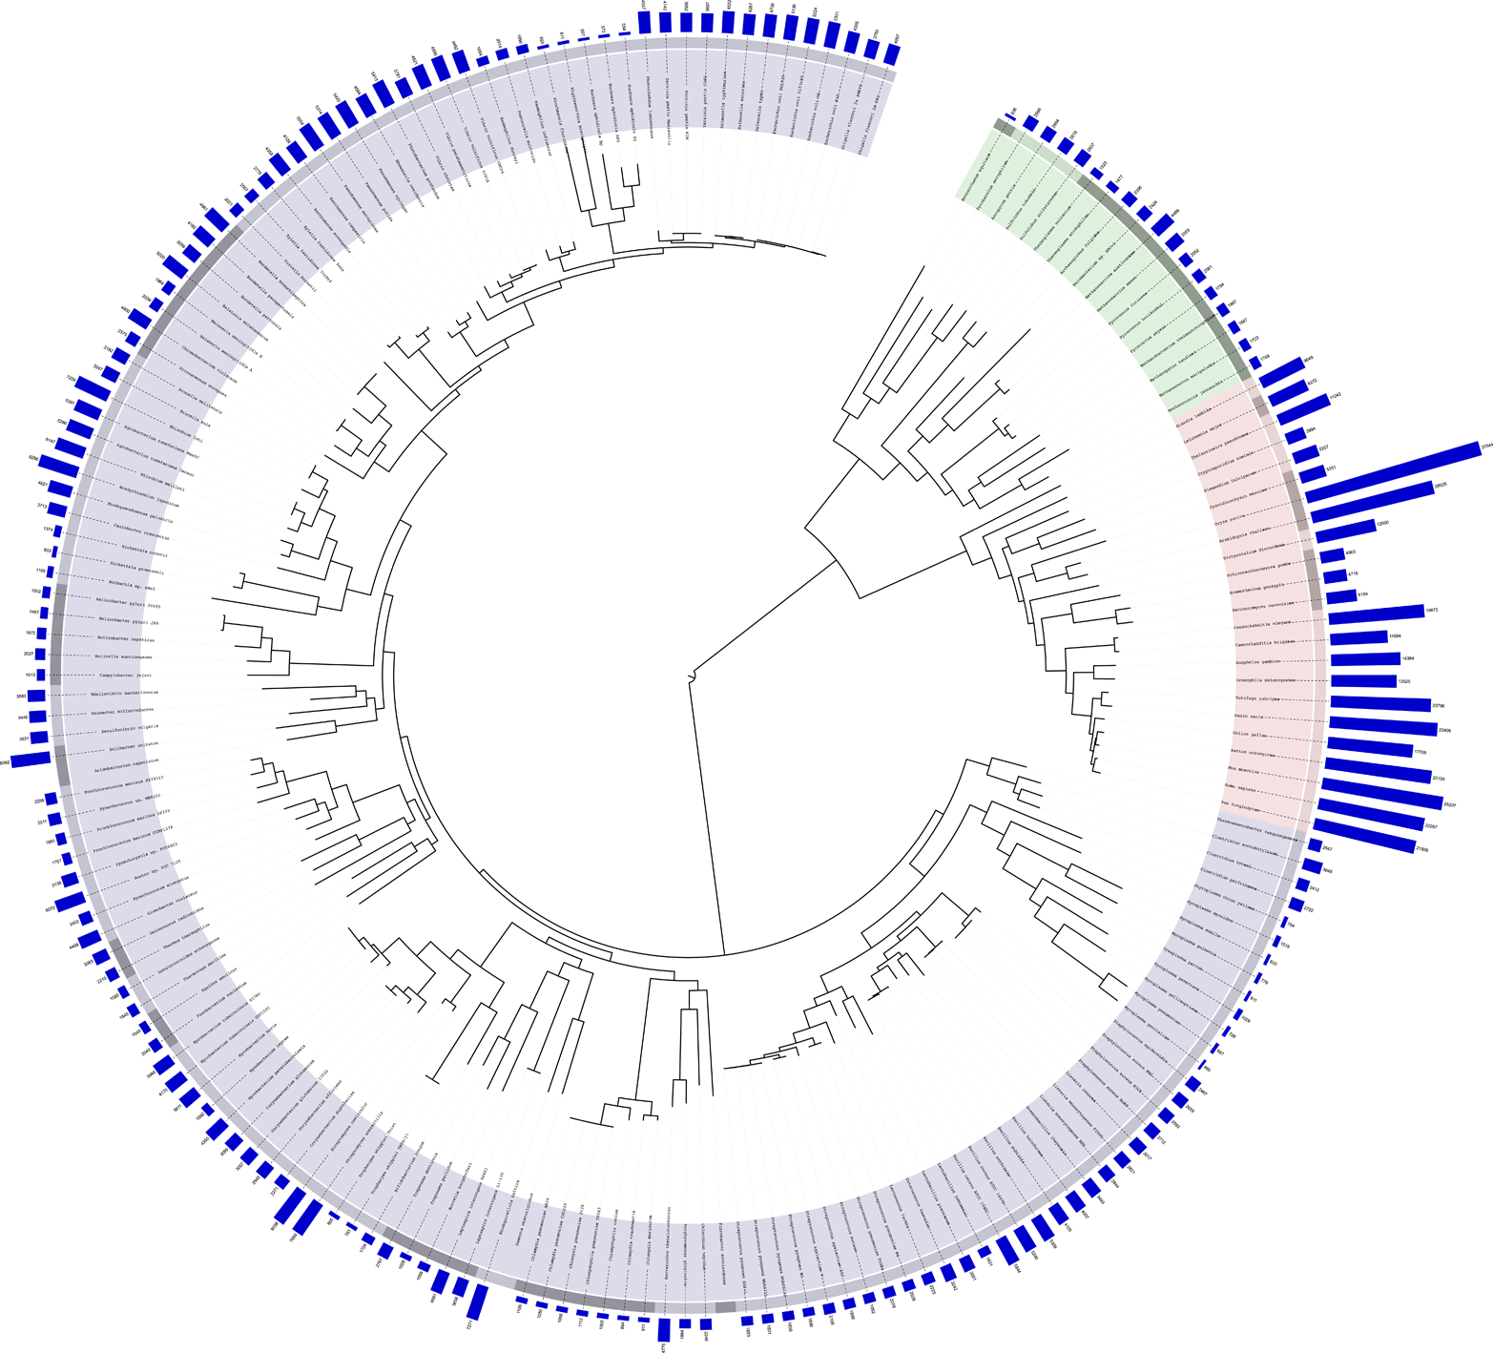
The tree of life is a dendogram
Here’s one showing only species with fully-sequenced genomes as of 2006…
http://itol.embl.de/itol.cgi#

Slide 27
Alternative: Centroid-based clustering

Slide 28
Hierarchical clustering vs centroid-based clustering
Hierarchical clustering considers individual points and the distance between then
Centroid-based clustering considers the whole group of points at once
A “centroid” is a cluster center
k-means is a common centroid clustering algorithm
each centroid is the “mean” of its points
You decide k – the number of “centroids” (groups)
Start with the centroids in some spot (maybe random placement)

Slide 29
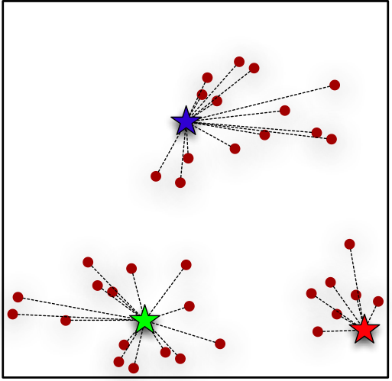
Stars are the centroids at their starting points
algorithm groups the points based on which centroid they are closest to
the means of the grouped values are calculated, which determines the new centroids…

Slide 30
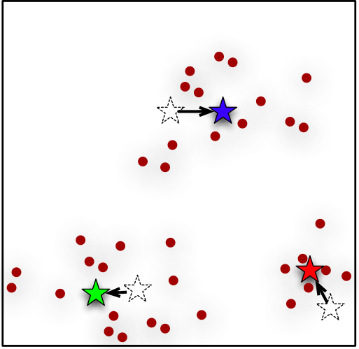
… which moves the centroids. The whole process is repeated…
Points are grouped based on which centroid they are closest to,
new centroids are calculated,
etc.
You “stop” the algorithm usually when the centroids stop moving around much.

Slide 31
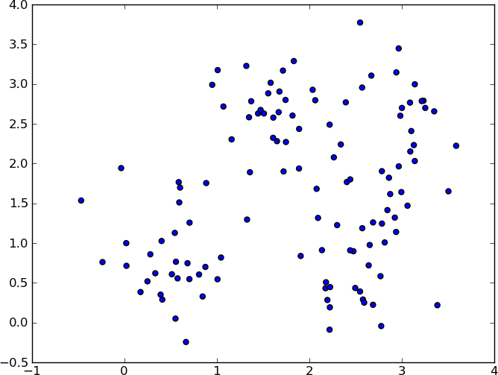
Another example
Let’s pick k=3 again
Intuitively, where would you place the centroids for k=3?

Slide 32
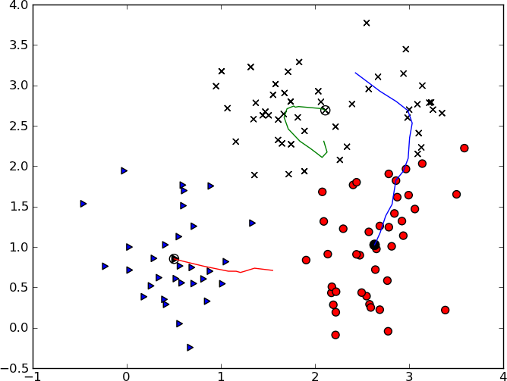
Centroids start here
Centroids end up here
Shapes are the final group membership based on nearest centroid

Slide 33
Understanding the Results of Clustering
So you have your k different groups. Let’s say you have dozens of dimensions. From there, how might you “label” the different groups? How might you describe them?
One option: average dimension values – (essentially the centroid)
But other centroids might have the same average values for some dimensions…
Another option: by what makes the groups different from all other groups
For this, used supervised learning to generate cluster descriptions

Slide 34
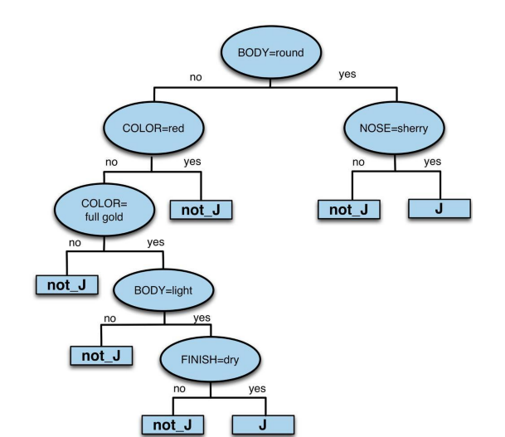
Supervised learning to describe cluster
Here’s the tree for “Group J”. How would you describe “Group J”, based on the tree?
Call each cluster a “class”
Analyze one “class” at a time
Set the “target variable” for all rows to indicate whether or not (binary) it is the current class being analyzed
Use something descriptive like a decision tree to predict whether it is a member of the class or not
Whiskeys in group J are described as…
“A round body and a sherry nose,”
or
“A full gold (but not red) color with a light (but not round) body and a dry finish.”

Slide 35
How to use clustering for supervised learning? Capital One example
First, use all available features and cluster all current customers to identify natural groups.
What kind of customer groups might you identify, based on their credit card usage behavior?
Then, use supervised learning to train a model using only the features that will be available at application time
Then, use that model at application time to produce probabilities for cluster membership
Viola, you have used unsupervised learning to circle back and inform supervised learning

Slide 36
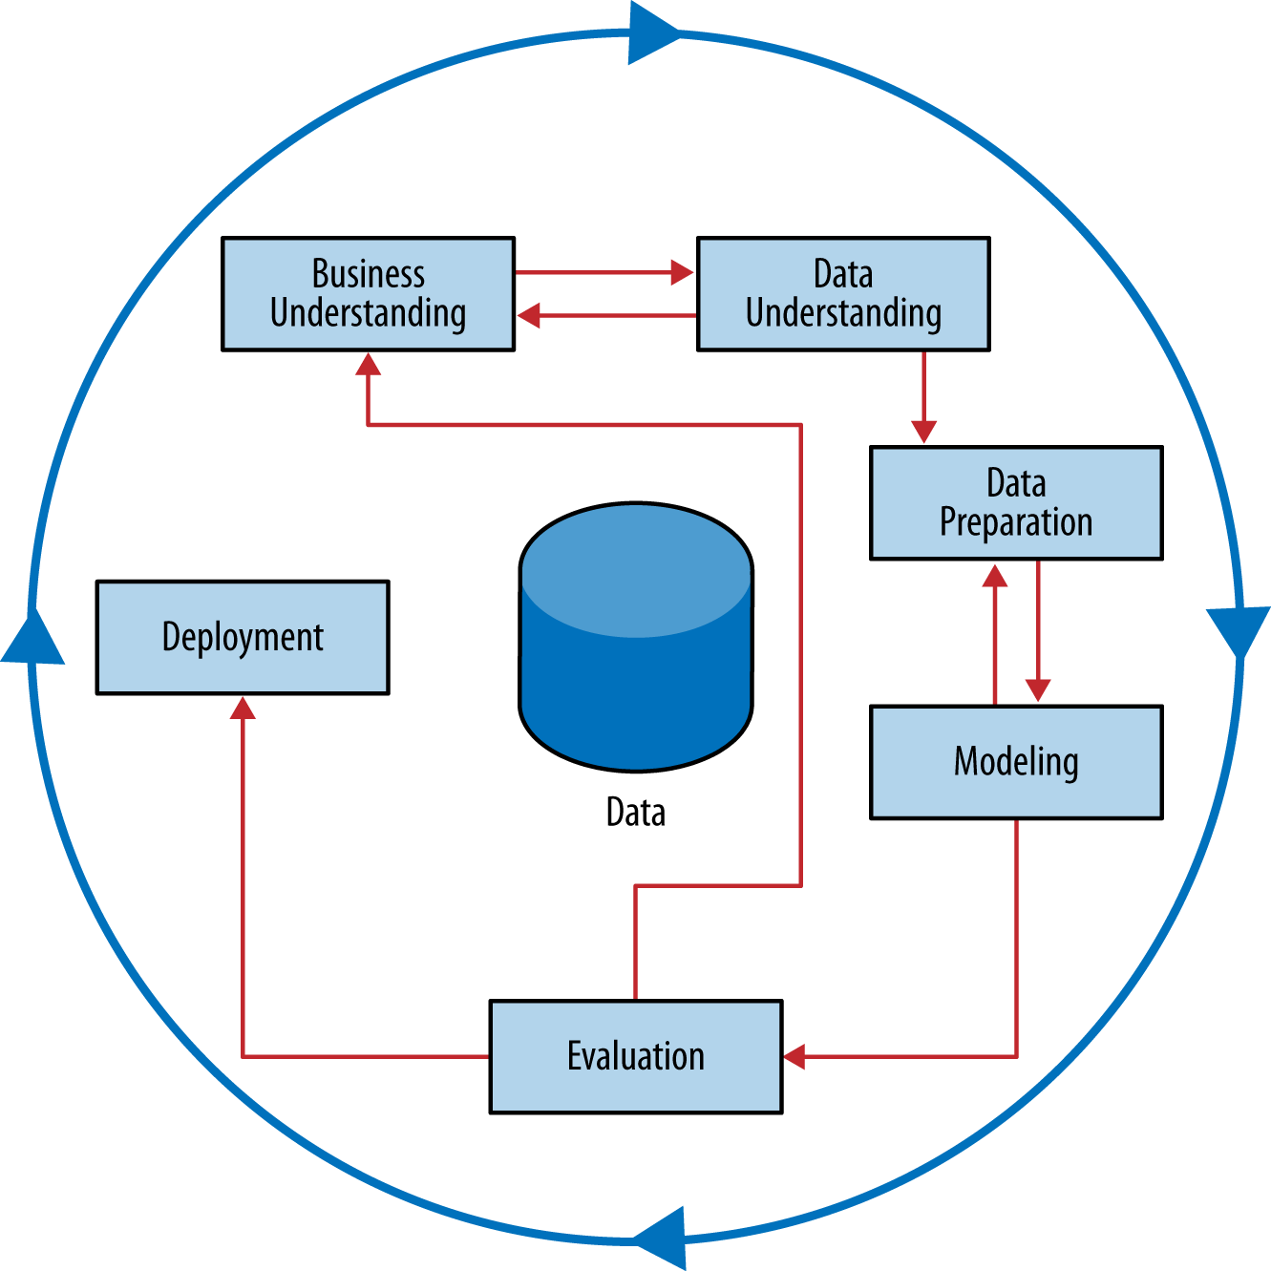
Unsupervised learning is very fast in the earlier stages (because you often simply don’t yet understand your business question or your data), but takes longer in the evaluation stage.

Slide 37
Many figures in this slide deck from Provost, F., & Fawcett, T. (2013). Data science for business: what you need to know about data mining and data-analytic thinking. Sebastopol, Calif.: O'Reilly.

